Slide 1
Introduction to Decentralized Finance
NFT & price bubbles

Slide 2
What is NFT?
An NFT is a digital asset based on a blockchain technology.
It represents Internet collectibles like art, music, and games with an authentic certificate created by blockchain technology that underlies Cryptocurrency.
The letters NFT stands for Non-Fungible Token. Non-fungible means that it can neither be replaced nor interchanged because it has unique properties.
The purchase of NFT takes place with cryptocurrencies such as Bitcoin and Ether, on specialist sites.

Slide 3
What is the economic significance of NFTs?
What are the benefits?
What type of problems do they solve?
For which market?

Slide 4
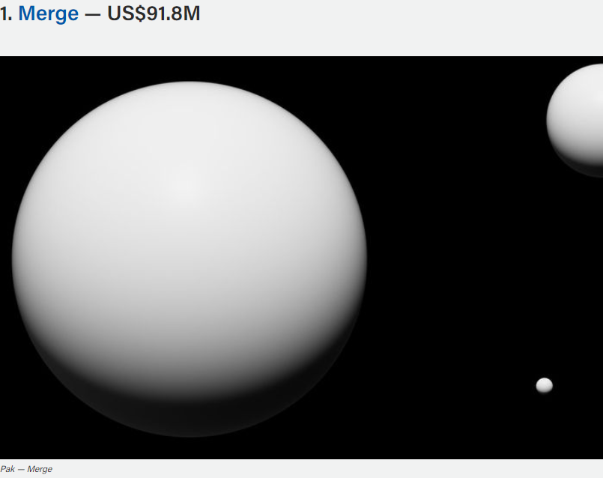

Slide 5
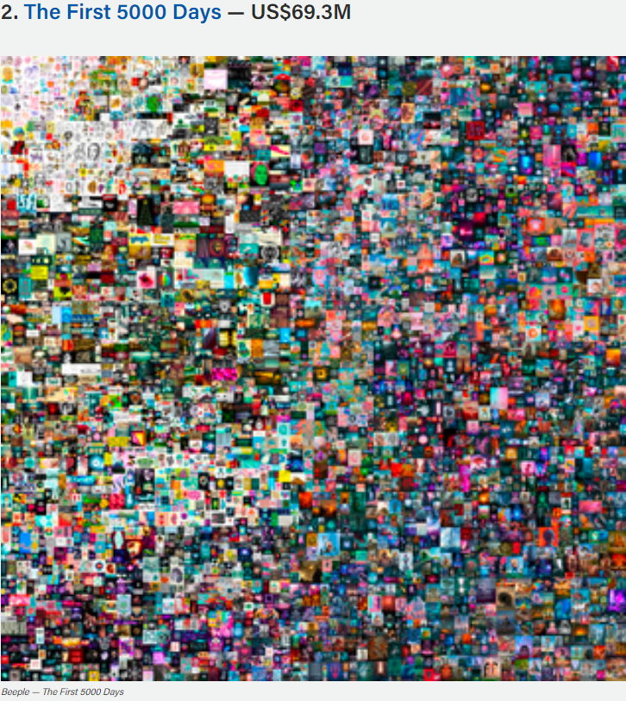

Slide 6


Slide 7
What is the future of NFT, cryptocurrencies, etc?
Are we in the midst of a bubble?

Slide 8

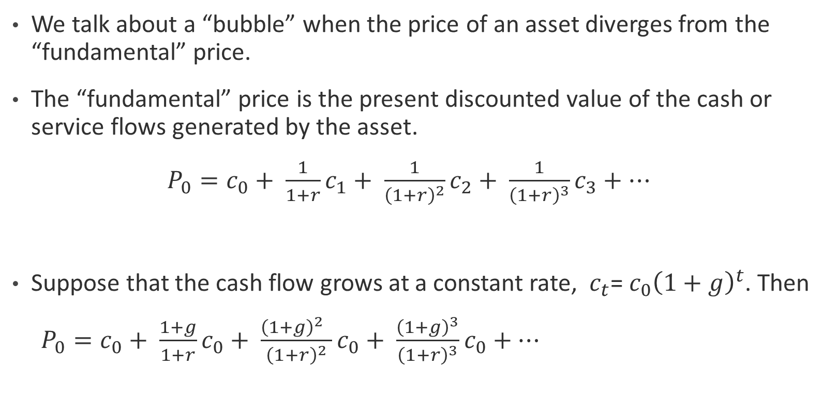
What is a bubble?
We talk about a “bubble” when the price of an asset diverges from the “fundamental” price.
The “fundamental” price is the present discounted value of the cash or service flows generated by the asset.
$P_{0}=c_{0}+ \frac{1}{1+r}c_{1}+ \frac{1}{{\left(1+r\right)}^{2}}c_{2}+ \frac{1}{{\left(1+r\right)}^{3}}c_{3}+…$
Suppose that the cash flow grows at a constant rate, $c_{t}$= $c_{0}{\left(1+g\right)}^{t}$. Then
$P_{0}=c_{0}+ \frac{1+g}{1+r}c_{0}+ \frac{{\left(1+g\right)}^{2} }{{\left(1+r\right)}^{2}}c_{0}+ \frac{{\left(1+g\right)}^{3}}{{\left(1+r\right)}^{3}}c_{0}+…$
$$P_{0}= \frac{1+r}{r−g}c_{0}$$

Slide 9
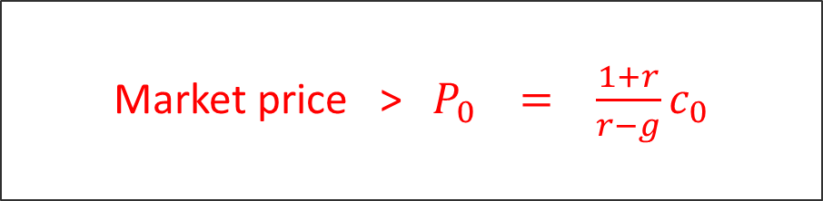
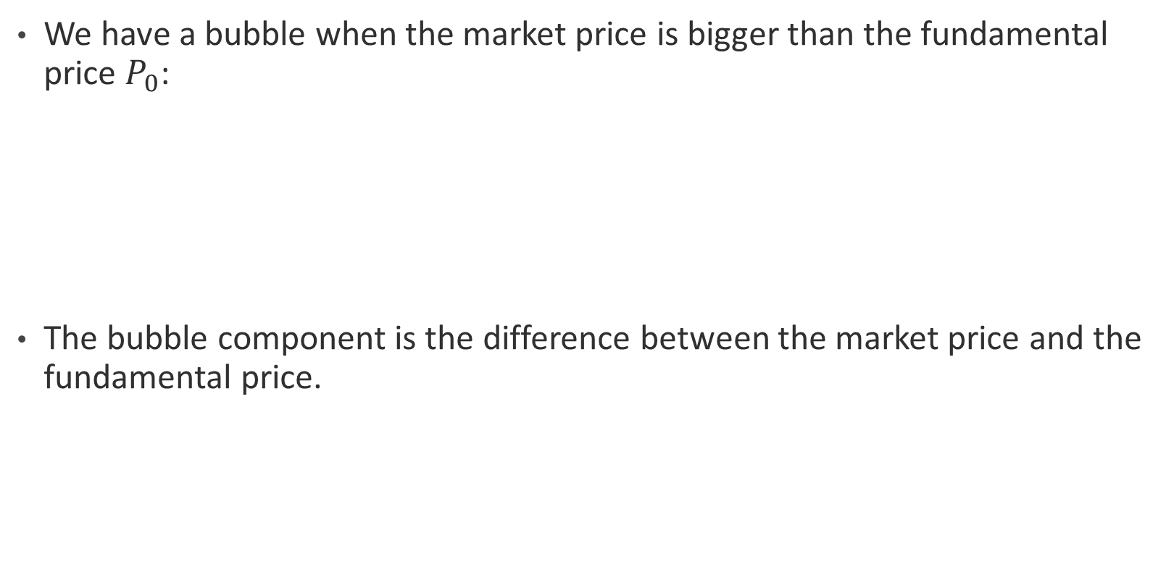
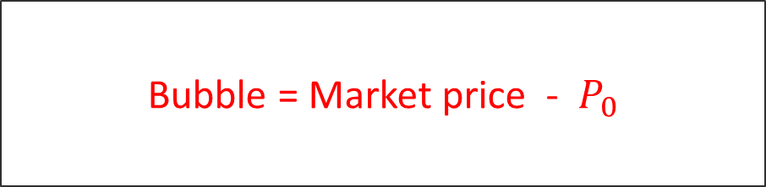
What is a bubble?
We have a bubble when the market price is bigger than the fundamental price $P_{0}$:
The bubble component is the difference between the market price and the fundamental price.
Market price > $P_{0} = \frac{1+r}{r−g}c_{0}$
Bubble = Market price - $P_{0}$

Slide 10
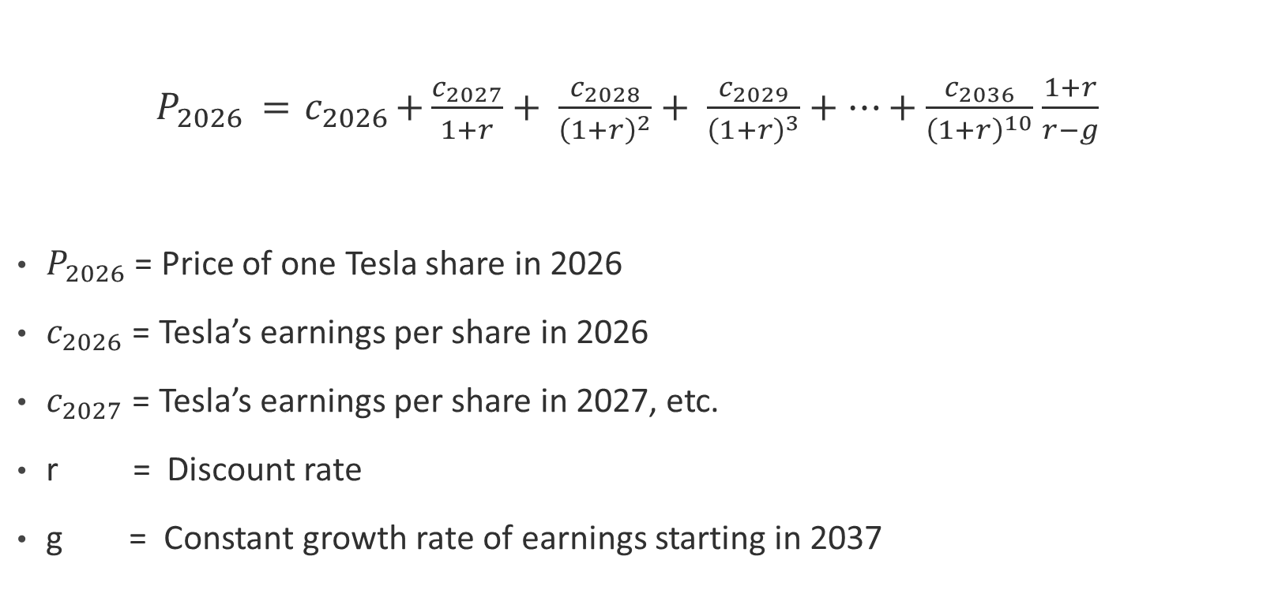
Value of one Tesla’s share in 2026
${ P}_{2026} ={ c}_{2026}+\frac{c_{2027}}{1+r}+ \frac{c_{2028}}{{\left(1+r\right)}^{2}}+ \frac{c_{2029}}{{\left(1+r\right)}^{3}}+…+\frac{c_{2036}}{{\left(1+r\right)}^{10}}$ $\frac{1+r}{r−g}$
$P_{2026}$ = Price of one Tesla share in 2026
$c_{2026}$ = Tesla’s earnings per share in 2026
$c_{2027}$ = Tesla’s earnings per share in 2027, etc.
r = Discount rate
g = Constant growth rate of earnings starting in 2037

Slide 11
Anatomy of an asset price bubble
Stage 1: Displacement
Investors get exited about new and innovative products. Often this is associated to an increase in wealth or liquidity.
Stage 2: Price boom
Demand for the asset increases rapidly but supply cannot keep up. The increase demand is fueled by expectation of higher future prices.
Stage 3: Euphoria
More and more buyers get into the market attracted by the rising price. This causes an even faster price increase.
Stage 4: Profit taking
Some investors start to realize that the price is disjoint from the fundamental price, so they start to liquidate. The price stops growing and possibly starts declining.
Stage 5: Panic
Investors rush to sell and cause the bubble to burst.

Slide 12
Innovations in financial markets The case of securitization and shadow banking growth and the 2008 crisis

Slide 13
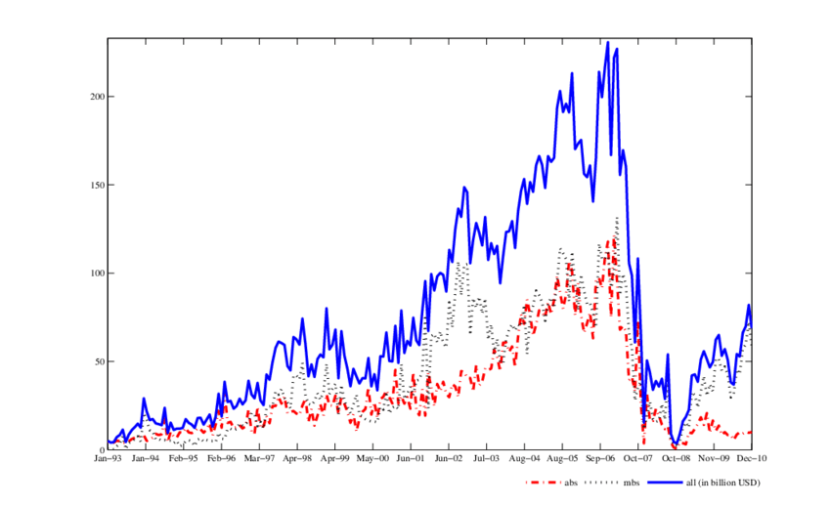
Securitization

Slide 14
Securitization

Slide 15
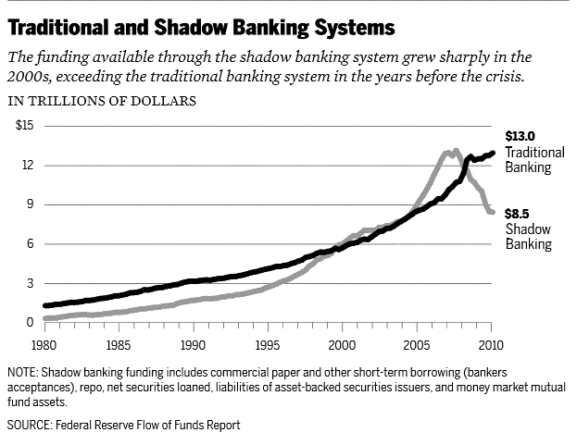

Slide 17
Innovations in financial markets Is the growth of DeFi a replication of the securitization and shadow banking growth?

Slide 18
Metaverse

Slide 19
What is metaverse?
Spatial computing platform that provides digital experiences as an alternative to or a replica of the real world, along with key civilizational aspects like social interactions, currency, trade, economy, and property ownership – founded on a bedrock of blockchain technology.

